Slide 1
CS2030 LAB 4
B12A

Slide 2
Lab Admin
01
Topic Coverage
02
AGENDA
Start coding!
03

Slide 3
Attendance

Slide 4
01
Lab Admin
Important Information!

Slide 5
Lab Admin (Announcements)
Project
PA1
GitHub Handle

Slide 6
Project
Project has been released on CodeCrunch (worth 10%)
Split into 2 levels
Style is graded for labs! JavaDocs will need to be written for public methods
More information will be released soon

Slide 7
Practical Assessment 1
Submit final changes by Sunday, 2359
Sample solution is available on LumiNUS; however, do note that your grading will still be based on similarity so no point blindly copying

Slide 8
GitHub Handle
Please send your GitHub username to me by the end of today; i.e. Friday, 2359
If you don’t have, just go and create – you will need it eventually
If not, you will get 0% for class participation
These people have not submitted:
Chu Jia-Cheng
Jerome Seah
Lo Zhao Wei
Sun Jiaze
Xia Yaxin
Brandon Yap

Slide 9
Topic Coverage
Inheritance and interfaces
Basic generics
Producer Extends, Consumer Super
Java HashMap API

Slide 10
Java Generics - Introduction
Where have you seen generics before?
→ List<Circle> circles = new ArrayList<>();
Have you wondered why a List can store many different types of Objects without needing to explicitly declare what type it is?

Slide 11
Java Generics - Introduction
T is known as a generic type (can also be any other capital letter)
e.g. declaring Box<Integer> will replace all instances of T in your code with Integers
public class Box<T> {
private T item;
public Box(T item) {
this.item = item;
}
}

Slide 12
Java Generics - Introduction
We say that T belongs to an instance of Box, and every instance of Box can have a different type that is assigned to T
Do note that generics do not work with primitive types
Box<int> ❌
Box<Integer> ✅ → use Wrapper classes
However, recall that static methods belong to the class itself, and not to any instance of a class
Then how do we use generics with static methods?

Slide 13
Java Generics - Static methods
We must explicitly declare generic types for static methods
This is so that the generic type can be created for that specific method
public class Box<T> {
private T item;
public static <T> Box<T> empty() {
// Pink T replaces all the Ts in this method
}
}

Slide 14
Java Generics - Static methods
public class Box<T> {
private T item;
public static <T> Box<T> empty() {
// Pink T replaces all the Ts in this method
}
}
In this example, the BLUE T represents an instance level declaration, which will NOT be available in static methods
The PINK T is declared at the start of the static method, and therefore only exists within the scope of the static method

Slide 15
Java Generics - Bounded wildcards
Box<? extends T> → Box can have any subclass of T
We call this lower bounded wildcard
Box<? super T> → Box can have any superclass of T
We call this upper bounded wildcard
Box<?> == Box<? extends Object> → basically Box can have anything (not recommended to use unless explicitly asked by the question)
<?> is more general than <Object> in this case
Anything that extends Object (which is everything in Java) can be added to <?>

Slide 16
PECS
PECS = Producer Extends, Consumer Super
Use <? extends> if you want to read from a collection
Use <? super> if you want a collection to consume something (you want to add things to it)
Simply use <T> (don’t use bounded wildcards) if you intend to do both

Slide 17
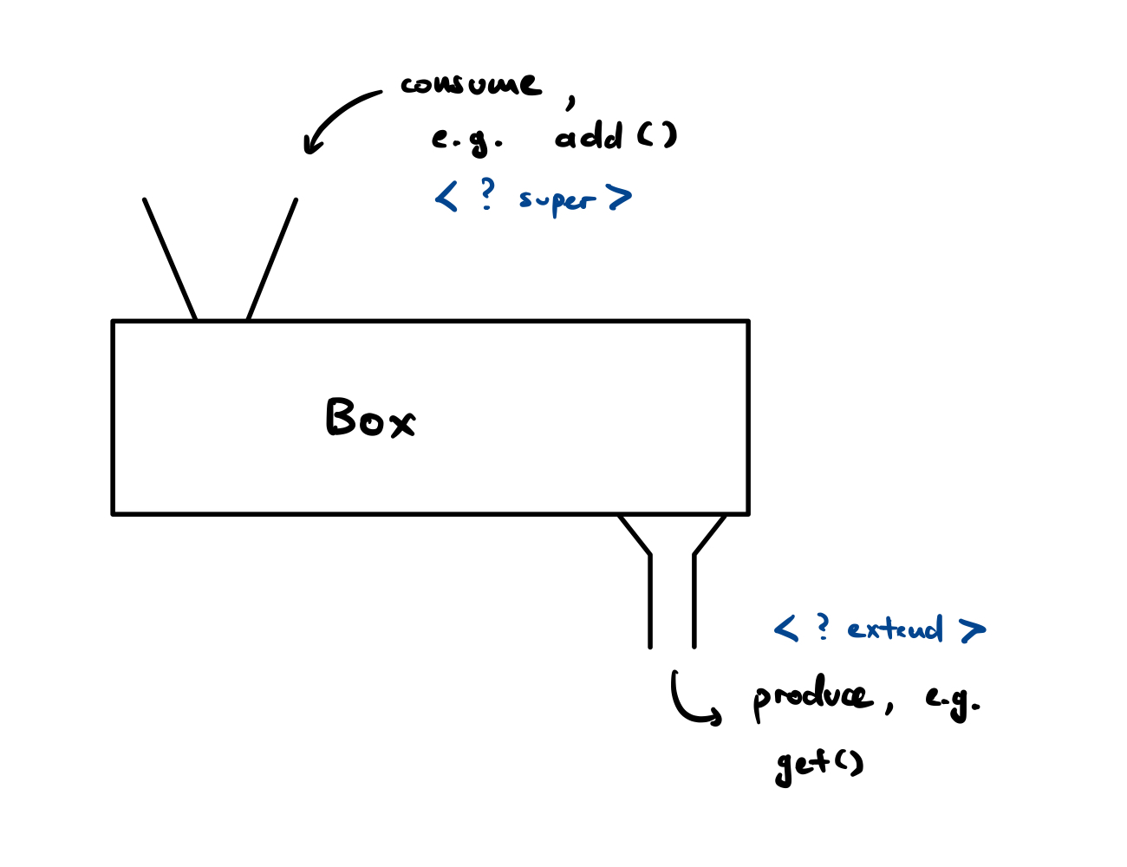
PECS

Slide 18
PECS - Covariance, Contravariance, Invariance
For the upcoming example, take note of the following information:
Covariance: Integer and Double are subtypes of Number
Contravariance: Number is a supertype of Integer and Double
Invariance: Integer and Double are invariant

Slide 19
Please pay attention, there will be a lab demo now!

Slide 20
PECS
Credits to lab demo can be found here (also if you want further reference): https://stackoverflow.com/questions/4343202/difference-between-super-t-and-extends-t-in-java

Slide 21
Java Map/HashMap
Map: a data structure that maps a key to a value (basically stores key-value pairs)
Similar to dictionary in Python
Only one key can be mapped to one value (1 to 1 mapping)
Mapping an existing key to another value will replace the current mapping in the map

Slide 22
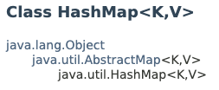
Java Map/HashMap
HashMap: a map backed by a hash table (CS2040)
Require generic types for the key, and for the value
e.g. HashMap<Integer, String> map = new HashMap<Integer, String> → Integer as key, String as value
we can also do HashMap<Integer, Integer> map = new HashMap<Integer, Integer> (the key and value do not need to be of different types!)

Slide 23
Java HashMap API
Method name | Description
.put(YourClass key, YourClass value) | Adds key to the HashMap with the value value
.clear() | Clears the HashMap
.containsKey(Object o) | Checks if key o is in the HashMap, based off the object’s equals() method
.containsValue(Object o) | Checks if value o is in the HashMap, based off the object’s equals() method
.get(Object o) | Gets the value corresponding to the key o
.isEmpty() | Checks if the HashMap is empty

Slide 24
Java HashMap API
Method name | Description
.remove(Object o) | Removes the entry with key o if it is in the HashMap, based off the object’s equals() method
.size() | Returns the number of elements in the HashMap
.entrySet() | Returns a set of all entries in the HashMap
.keySet() | Returns a set of all keys in the HashMap
.values() | Returns a collection of all values in the HashMap

Slide 25
Java HashMap API
More info is found here: https://docs.oracle.com/en/java/javase/11/docs/api/java.base/java/util/HashMap.html

Slide 26
Start coding!

Slide 27
Attendance

Slide 28
Invariance, Covariance and Contravariance (Further reading)
A and B are types
f is a type transformation
≤ is the subtype relation (i.e. A ≤ B means that A is a subtype (subclass) of B)
f is covariant if A ≤ B implies that f(A) ≤ f(B)
f is contravariant if A ≤ B implies that f(B) ≤ f(A)
f is invariant if neither of the above holds

Slide 29
Invariance, Covariance and Contravariance (Further reading)
In this case, assume that f maps the type to a data structure containing objects of that type
In Java, arrays are covariant
Object[] items = new String[1]; // Ok; String is a subclass of Object

Slide 30
Invariance, Covariance and Contravariance (Further reading)
On the other hand, generics are invariant
ArrayList<String> strings = new ArrayList<Object>(); // Compile error
ArrayList<Object> objects = new ArrayList<String>(); // Compile error

Slide 31
Invariance, Covariance and Contravariance (Further reading)
Therefore, List<?> is not the same as List<Object>
List<?> is more general than List<Object> because as mentioned above, <?> is synonymous with <? extends Object>
List<?> can store instances of type Object or any subclass of Object, i.e. List<?> can store anything since all other classes are subclasses of Object

